Slide 1

Department of Computer Science & Engineering Artificial Intelligence & Machine Learning A.P. Shah Institute of Technology G.B.Road,Kasarvadavli, Thane(W), Mumbai-400615 UNIVERSITY OF MUMBAI Academic Year 2023-2024

Slide 2
DIABETES PREDICTION SYSTEM USING AI
Computer Science & Engineering
(Artificial Intelligence and Machine Learning)
By
Harsh Kokitkar(21106029)
Vinayak Kokare(21106052)
Himanshu Rajput(21106055)
Priyesh Mangela(21106049)
Under the Guidance of
Prof. Ranjita Asati

Slide 3
Index
Introduction
Objectives
Features
Literature survey
Block Diagram
Tools/Software, Languages used
Implementation
Conclusion
References

Slide 4
Introduction
Diabetes is a chronic medical condition that affects millions of people worldwide, and its prevalence is steadily increasing.
Early detection and effective management of diabetes are crucial to preventing complications and improving the quality of life for those affected.
Artificial Intelligence (AI) has emerged as a powerful tool in the healthcare industry, offering the potential to enhance diabetes prediction, diagnosis, and management.
This project aims to develop a Diabetes Prediction System using AI to help identify individuals at risk of developing diabetes, enabling timely intervention and personalized care.

Slide 5
Objectives
Early Risk Identification: The system will leverage AI algorithms and machine learning techniques to analyze a range of patient data and identify individuals at an increased risk of developing diabetes. This includes both type 1 and type 2 diabetes.
Prediction Accuracy: The system aims to achieve high accuracy in predicting diabetes risk, ensuring that individuals with a higher likelihood of developing the condition are not overlooked. This will help in early intervention and prevention.
Personalized Recommendations: The system will provide personalized recommendations and interventions for individuals identified as high-risk, enabling them to take proactive steps to manage their health and reduce their diabetes risk.
Data Integration: The system will integrate a variety of data sources, including electronic health records, patient demographics, medical history, genetics, lifestyle data, and clinical measurements, to create a comprehensive risk assessment.

Slide 6
Features
Data Collection and Integration: The system will collect and integrate patient data from various sources, such as medical records, lifestyle information, genetics, and clinical measurements.
Machine Learning Algorithms: Advanced machine learning algorithms, including logistic regression, decision trees, and neural networks, will be employed to analyze the integrated data and predict diabetes risk.
Alerts and Notifications: Healthcare professionals will receive alerts and notifications regarding high-risk patients, allowing for timely intervention and patient management.
Data Security and Privacy: The system will prioritize data security and patient privacy, complying with all relevant healthcare data protection regulations.

Slide 7
Literature Survey

Slide 8
Sr. No | Title | Author Name | Description
1. | "Predicting the Onset of Diabetes Mellitus: A Machine Learning Model" | Authors: Namita Arora, et al. Published in: 2020 | This study explores the application of machine learning models, such as Random Forest and Support Vector Machines, in predicting the onset of diabetes based on patient data, including clinical and lifestyle factors
2. | "Deep Learning for Diabetes Prediction Using Pima Indian Diabetes Dataset" | Authors: Rajendran Dinesh Kumar, et al. Published in: 2020 | This research uses deep learning techniques to predict diabetes outcomes using the well-known Pima Indian Diabetes dataset, achieving high accuracy

Slide 9
Sr. No | Title | Author Name | Description
3. | “Predicting Diabetes Mellitus Using Machine Learning Techniques” | Authors: Shiwani Agrawal, et al. Published in: 2017 | This study explores the application of various machine learning algorithms for diabetes prediction and compares their performance using clinical data.
4. | "Early Detection of Diabetes Retinopathy in Fundus Images Using Convolutional Neural Networks" | Authors: Gulshan Saini, et al. Published in: 2018 | While this study focuses on diabetic retinopathy, it demonstrates the use of convolutional neural networks (CNNs) for the early detection of diabetic complications, which can be an essential component of a comprehensive diabetes prediction system.

Slide 10
Sr. No | Title | Author Name | Description
5. | "A Review on Machine Learning in Diabetic Retinopathy Prediction" | Authors: Vijay R. Palanisamy, et al. Published in: 2019 | This review article discusses the application of machine learning techniques, including deep learning and CNNs, for the early prediction of diabetic retinopathy, a common complication of diabetes.

Slide 11
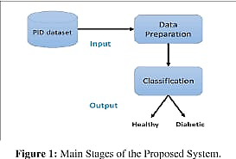
BLOCK DIAGRAM

Slide 12

Tools/software, Languages used
Python – version (3.10)
Google Colab
GUI – Flask Python

Slide 13
PROJECT WORK

Slide 14
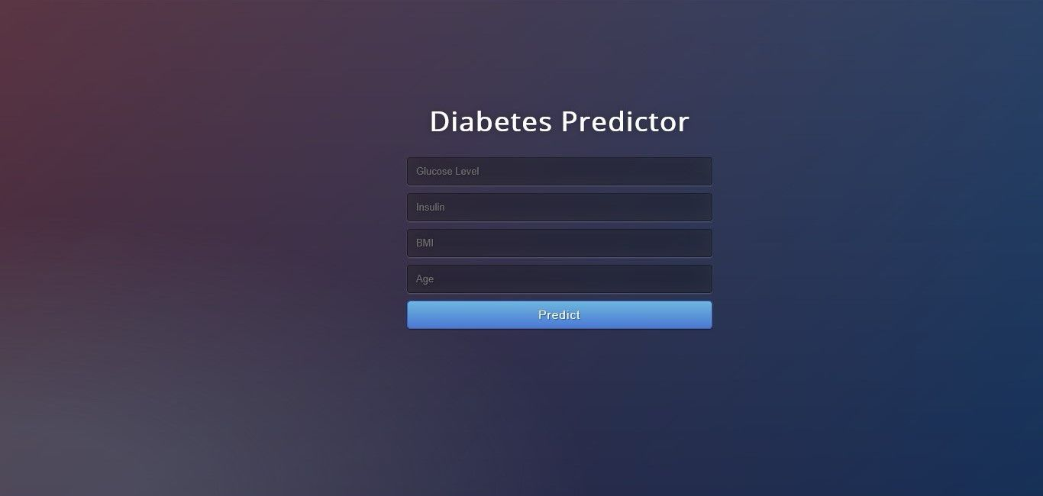
Implementation

Slide 15
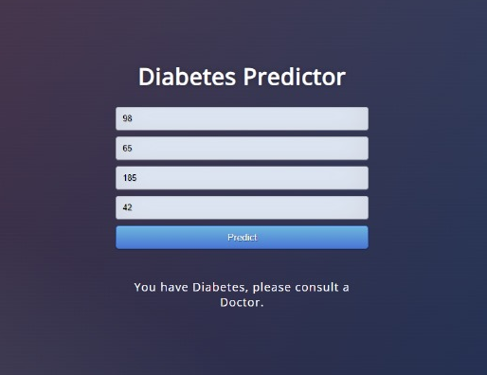

Implementation

Slide 16
Conclusion
In conclusion, the development of a Diabetes Prediction System using AI holds significant promise in the healthcare field.
This system harnesses the power of artificial intelligence to enhance the early identification of individuals at risk of developing diabetes, providing numerous potential benefits

Slide 17
References
Journal Papers :
[1] Cho, S. H., & Lee, J. H. (2020). Diabetes prediction using machine learning and big data. Healthcare Informatics Research, 26(3), 156-163.
[2] Pham, N. M., & Egger, G. (2019). A data-driven approach to predicting diabetes and cardiovascular disease with machine learning. BMC Medical Informatics and Decision Making, 19(1), 211.
[3] Alhusaini, W. S., & Ahmed, M. (2021). Predicting diabetes disease based on machine learning and deep learning algorithms. Health Information Science and Systems, 9(1), 1-11.
[4] Fernández, A., García, S., Galar, M., Prati, R. C., & Krawczyk, B. (2018). An insight into imbalanced big data classification: outcomes and challenges. Complex & Intelligent Systems, 4(3), 209-220.
[5] Gargeya, R., & Leng, T. (2017). Automated identification of diabetic retinopathy using deep learning. Ophthalmology, 124(7), 962-969.
Useful Links :
[6] https://youtu.be/dMaNiabqVdo?si=n-b62uOvtpxoxz6F
[7] https://youtu.be/PY_N1XdFp4w?si=mSHsvR5sbb16Ck9V
[8] https://youtu.be/rHux0gMZ3Eg?si=L6mwAZiJi7wRnwc3

Slide 18
THANK YOU

